Slide 1

Big Data Privacy Preservation
Rong-Hua Li
School of Computer Science & Technology, BIT Emial: lironghuabit@126.com
Personal Homepage: ronghuali.github.io
Lab Homepage: gdilab.cn

Slide 2
Outline
Part 1
Introduction to Anonymization and Uncertainty
Tabular Data Anonymization
Part 2
Differential privacy
Local Differential privacy

Slide 3
Why Anonymize?
For Data Sharing
Give real(istic) data to others to study without compromising privacy of individuals in the data
Allows third-parties to try new analysis and mining techniques not thought of by the data owner
For Data Retention and Usage
Various requirements prevent companies from retaining customer information indefinitely
E.g. Google progressively anonymizes IP addresses in search logs
Internal sharing across departments (e.g. billing → marketing)

Slide 4

Why Privacy?
Data subjects have inherent right and expectation of privacy
“Privacy” is a complex concept (beyond the scope of this lecture)
What exactly does “privacy” mean? When does it apply?
Could there exist societies without a concept of privacy?
Concretely: at collection “small print” outlines privacy rules
Most companies have adopted a privacy policy
E.g. AT&T privacy policy att.com/gen/privacy-policy?pid=2506
Significant legal framework relating to privacy
UN Declaration of Human Rights, US Constitution
HIPAA, Video Privacy Protection, Data Protection Acts

Slide 5

Case Study: US Census
Raw data: information about every US household
Who, where; age, gender, racial, income and educational data
Why released: determine representation, planning
How anonymized: aggregated to geographic areas (Zip code)
Broken down by various combinations of dimensions
Released in full after 72 years
Attacks: no reports of successful deanonymization
Recent attempts by FBI to access raw data rebuffed
Consequences: greater understanding of US population
Affects representation, funding of civil projects
Rich source of data for future historians and genealogists

Slide 6

Case Study: Netflix Prize
Raw data: 100M dated ratings from 480K users to 18K movies
Why released: improve predicting ratings of unlabeled examples
How anonymized: exact details not described by Netflix
All direct customer information removed
Only subset of full data; dates modified; some ratings deleted,
Movie title and year published in full
Attacks: dataset is claimed vulnerable [Narayanan Shmatikov 08]
Attack links data to IMDB where same users also rated movies
Find matches based on similar ratings or dates in both
Consequences: rich source of user data for researchers
Unclear how serious the attacks are in practice

Slide 7

Case Study: AOL Search Data
Raw data: 20M search queries for 650K users from 2006
Why released: allow researchers to understand search patterns
How anonymized: user identifiers removed
All searches from same user linked by an arbitrary identifier
Attacks: many successful attacks identified individual users
Ego-surfers: people typed in their own names
Zip codes and town names identify an area
NY Times identified 4417749 as 62yr old GA widow [Barbaro Zeller 06]
Consequences: CTO resigned, two researchers fired
Well-intentioned effort failed due to inadequate anonymization

Slide 8
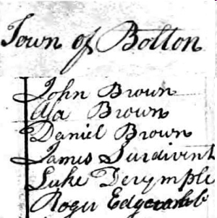


Three Abstract Examples
“Census” data recording incomes and demographics
Schema: (SSN, DOB, Sex, ZIP, Salary)
Tabular data—best represented as a table
“Video” data recording movies viewed
Schema: (Uid, DOB, Sex, ZIP), (Vid, title, genre), (Uid, Vid)
Graph data—graph properties should be retained
“Search” data recording web searches
Schema: (Uid, Kw1, Kw2, …)
Set data—each user has different set of keywords
Each example has different anonymization needs

Slide 9
Models of Anonymization
Interactive Model (akin to statistical databases)
Data owner acts as “gatekeeper” to data
Researchers pose queries in some agreed language
Gatekeeper gives an (anonymized) answer, or refuses to answer
“Send me your code” model
Data owner executes code on their system and reports result
Cannot be sure that the code is not malicious
Offline, aka “publish and be damned” model
Data owner somehow anonymizes data set
Publishes the results to the world, and retires
Our focus in this lecture – seems to model most real releases

Slide 10
Objectives for Anonymization
Prevent (high confidence) inference of associations
Prevent inference of salary for an individual in “census”
Prevent inference of individual’s viewing history in “video”
Prevent inference of individual’s search history in “search”
All aim to prevent linking sensitive information to an individual
Prevent inference of presence of an individual in the data set
Satisfying “presence” also satisfies “association” (not vice-versa)
Presence in a data set can violate privacy (eg STD clinic patients)
Have to model what knowledge might be known to attacker
Background knowledge: facts about the data set (X has salary Y)
Domain knowledge: broad properties of data (illness Z rare in men)

Slide 11
Utility
Anonymization is meaningless if utility of data not considered
The empty data set has perfect privacy, but no utility
The original data has full utility, but no privacy
What is “utility”? Depends what the application is…
For fixed query set, can look at max, average distortion
Problem for publishing: want to support unknown applications!
Need some way to quantify utility of alternate anonymizations

Slide 12
Measures of Utility
Define a surrogate measure and try to optimize
Often based on the “information loss” of the anonymization
Simple example: number of rows suppressed in a table
Give a guarantee for all queries in some fixed class
Hope the class is representative, so other uses have low distortion
Costly: some methods enumerate all queries, or all anonymizations
Empirical Evaluation
Perform experiments with a reasonable workload on the result
Compare to results on original data (e.g. Netflix prize problems)
Combinations of multiple methods
Optimize for some surrogate, but also evaluate on real queries

Slide 13
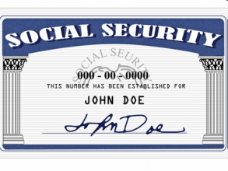
Definitions of Technical Terms
Identifiers–uniquely identify, e.g. Social Security Number (SSN)
Step 0: remove all identifiers
Was not enough for AOL search data
Quasi-Identifiers (QI)—such as DOB, Sex, ZIP Code
Enough to partially identify an individual in a dataset
DOB+Sex+ZIP unique for 87% of US Residents [Sweeney 02]
Sensitive attributes (SA)—the associations we want to hide
Salary in the “census” example is considered sensitive
Not always well-defined: only some “search” queries sensitive
In “video”, association between user and video is sensitive
SA can be identifying: bonus may identify salary…

Slide 14
Summary of Anonymization Motivation
Anonymization needed for safe data sharing and retention
Many legal requirements apply
Various privacy definitions possible
Primarily, prevent inference of sensitive information
Under some assumptions of background knowledge
Utility of the anonymized data needs to be carefully studied
Different data types imply different classes of query
Our focus: publishing model with careful utility consideration
Data types: tables (census), sets and graphs (video & search)

Slide 15
Anonymization as Uncertainty
We view anonymization as adding uncertainty to certain data
To ensure an attacker can’t be sure about associations, presence
It is important to use the tools and models of uncertainty
To quantify the uncertainty of an attacker
To understand the impact of background knowledge
To allow efficient, accurate querying of anonymized data
Much recent work on anonymization and uncertainty separately
Here, we aim to bring them together
More formal framework for anonymization
New application to drive uncertainty

Slide 16
Possible Worlds
Uncertain Data typically represents multiple possible worlds
Each possible world corresponds to a database (or graph, or…)
The uncertainty model may attach a probability to each world
Queries conceptually range over all possible worlds
Possibilistic interpretations
Is a given fact possible ( ∃ a world W where it is true) ?
Is a given fact certain ( ∀ worlds W it is true) ?
Probabilistic interpretations
What is the probability of a fact being true?
What is the distribution of answers to an aggregate query?
What is the (min, max, mean) answer to an aggregate query?

Slide 17
Outline
Part 1
Introduction to Anonymization and Uncertainty
Tabular Data Anonymization
Part 2
Differential privacy
Local Differential privacy

Slide 18
Tabular Data Example
Census data recording incomes and demographics
Releasing SSN → Salary association violates individual’s privacy
SSN is an identifier, Salary is a sensitive attribute (SA)
SSN | DOB | Sex | ZIP | Salary
11-1-111 | 1/21/76 | M | 53715 | 50,000
22-2-222 | 4/13/86 | F | 53715 | 55,000
33-3-333 | 2/28/76 | M | 53703 | 60,000
44-4-444 | 1/21/76 | M | 53703 | 65,000
55-5-555 | 4/13/86 | F | 53706 | 70,000
66-6-666 | 2/28/76 | F | 53706 | 75,000

Slide 19
Tabular Data Example: De-Identification
Census data: remove SSN to create de-identified table
Does the de-identified table preserve an individual’s privacy?
Depends on what other information an attacker knows
DOB | Sex | ZIP | Salary
1/21/76 | M | 53715 | 50,000
4/13/86 | F | 53715 | 55,000
2/28/76 | M | 53703 | 60,000
1/21/76 | M | 53703 | 65,000
4/13/86 | F | 53706 | 70,000
2/28/76 | F | 53706 | 75,000

Slide 20
Tabular Data Example: Linking Attack
De-identified private data + publicly available data
Cannot uniquely identify either individual’s salary
DOB is a quasi-identifier (QI)
DOB | Sex | ZIP | Salary
1/21/76 | M | 53715 | 50,000
4/13/86 | F | 53715 | 55,000
2/28/76 | M | 53703 | 60,000
1/21/76 | M | 53703 | 65,000
4/13/86 | F | 53706 | 70,000
2/28/76 | F | 53706 | 75,000
SSN | DOB
11-1-111 | 1/21/76
33-3-333 | 2/28/76

Slide 21
Tabular Data Example: Linking Attack
De-identified private data + publicly available data
Uniquely identified one individual’s salary, but not the other’s
DOB, Sex are quasi-identifiers (QI)
DOB | Sex | ZIP | Salary
1/21/76 | M | 53715 | 50,000
4/13/86 | F | 53715 | 55,000
2/28/76 | M | 53703 | 60,000
1/21/76 | M | 53703 | 65,000
4/13/86 | F | 53706 | 70,000
2/28/76 | F | 53706 | 75,000
SSN | DOB | Sex
11-1-111 | 1/21/76 | M
33-3-333 | 2/28/76 | M

Slide 22
Tabular Data Example: Linking Attack
De-identified private data + publicly available data
Uniquely identified both individuals’ salaries
[DOB, Sex, ZIP] is unique for lots of US residents [Sweeney 02]
DOB | Sex | ZIP | Salary
1/21/76 | M | 53715 | 50,000
4/13/86 | F | 53715 | 55,000
2/28/76 | M | 53703 | 60,000
1/21/76 | M | 53703 | 65,000
4/13/86 | F | 53706 | 70,000
2/28/76 | F | 53706 | 75,000
SSN | DOB | Sex | ZIP
11-1-111 | 1/21/76 | M | 53715
33-3-333 | 2/28/76 | M | 53703

Slide 23
Tabular Data Example: Anonymization
Anonymization through tuple suppression
Cannot link to private table even with knowledge of QI values
Missing tuples could take any value from the space of all tuples
Introduces a lot of uncertainty
DOB | Sex | ZIP | Salary
* | * | * | *
4/13/86 | F | 53715 | 55,000
2/28/76 | M | 53703 | 60,000
* | * | * | *
4/13/86 | F | 53706 | 70,000
2/28/76 | F | 53706 | 75,000
SSN | DOB | Sex | ZIP
11-1-111 | 1/21/76 | M | 53715

Slide 24
Tabular Data Example: Anonymization
Anonymization through QI attribute generalization
Cannot uniquely identify tuple with knowledge of QI values
More precise form of uncertainty than tuple suppression
E.g., ZIP = 537** → ZIP ∈ {53700, …, 53799}
DOB | Sex | ZIP | Salary
1/21/76 | M | 537** | 50,000
4/13/86 | F | 537** | 55,000
2/28/76 | * | 537** | 60,000
1/21/76 | M | 537** | 65,000
4/13/86 | F | 537** | 70,000
2/28/76 | * | 537** | 75,000
SSN | DOB | Sex | ZIP
11-1-111 | 1/21/76 | M | 53715
33-3-333 | 2/28/76 | M | 53703

Slide 25
Tabular Data Example: Anonymization
Anonymization through sensitive attribute (SA) permutation
Can uniquely identify tuple, but uncertainty about SA value
Much more precise form of uncertainty than generalization
Can be represented with c-tables, MayBMS in a tedious way
DOB | Sex | ZIP | Salary
1/21/76 | M | 53715 | 55,000
4/13/86 | F | 53715 | 50,000
2/28/76 | M | 53703 | 60,000
1/21/76 | M | 53703 | 65,000
4/13/86 | F | 53706 | 75,000
2/28/76 | F | 53706 | 70,000
SSN | DOB | Sex | ZIP
11-1-111 | 1/21/76 | M | 53715
33-3-333 | 2/28/76 | M | 53703

Slide 26
Tabular Data Example: Anonymization
Anonymization through sensitive attribute (SA) perturbation
Can uniquely identify tuple, but get “noisy” SA value
If distribution of perturbation is given, it implicitly defines a model that can be encoded in c-tables, Trio, MayBMS
DOB | Sex | ZIP | Salary
1/21/76 | M | 53715 | 60,000
4/13/86 | F | 53715 | 45,000
2/28/76 | M | 53703 | 60,000
1/21/76 | M | 53703 | 55,000
4/13/86 | F | 53706 | 80,000
2/28/76 | F | 53706 | 75,000
SSN | DOB | Sex | ZIP
11-1-111 | 1/21/76 | M | 53715
33-3-333 | 2/28/76 | M | 53703

Slide 27
k-Anonymization [Samarati, Sweeney 98]
k-anonymity: Table T satisfies k-anonymity wrt quasi-identifier QI iff each tuple in (the multiset) T[QI] appears at least k times
Protects against “linking attack”
k-anonymization: Table T’ is a k-anonymization of T if T’ is a generalization/suppression of T, and T’ satisfies k-anonymity
DOB | Sex | ZIP | Salary
1/21/76 | M | 53715 | 50,000
4/13/86 | F | 53715 | 55,000
2/28/76 | M | 53703 | 60,000
1/21/76 | M | 53703 | 65,000
4/13/86 | F | 53706 | 70,000
2/28/76 | F | 53706 | 75,000
DOB | Sex | ZIP | Salary
1/21/76 | M | 537** | 50,000
4/13/86 | F | 537** | 55,000
2/28/76 | * | 537** | 60,000
1/21/76 | M | 537** | 65,000
4/13/86 | F | 537** | 70,000
2/28/76 | * | 537** | 75,000
→

Slide 28
k-Anonymization and Uncertainty
Intuition: A k-anonymized table T’ represents the set of all “possible world” tables T_{i} s.t. T’ is a k-anonymization of T_{i}
The table T from which T’ was originally derived is one of the possible worlds
DOB | Sex | ZIP | Salary
1/21/76 | M | 537** | 50,000
4/13/86 | F | 537** | 55,000
2/28/76 | * | 537** | 60,000
1/21/76 | M | 537** | 65,000
4/13/86 | F | 537** | 70,000
2/28/76 | * | 537** | 75,000
DOB | Sex | ZIP | Salary
1/21/76 | M | 53715 | 50,000
4/13/86 | F | 53715 | 55,000
2/28/76 | M | 53703 | 60,000
1/21/76 | M | 53703 | 65,000
4/13/86 | F | 53706 | 70,000
2/28/76 | F | 53706 | 75,000
→

Slide 29
k-Anonymization and Uncertainty
Intuition: A k-anonymized table T’ represents the set of all “possible world” tables T_{i} s.t. T’ is a k-anonymization of T_{i}
(Many) other tables are also possible
DOB | Sex | ZIP | Salary
1/21/76 | M | 537** | 50,000
4/13/86 | F | 537** | 55,000
2/28/76 | * | 537** | 60,000
1/21/76 | M | 537** | 65,000
4/13/86 | F | 537** | 70,000
2/28/76 | * | 537** | 75,000
DOB | Sex | ZIP | Salary
1/21/76 | M | 53710 | 50,000
4/13/86 | F | 53715 | 55,000
2/28/76 | F | 53703 | 60,000
1/21/76 | M | 53703 | 65,000
4/13/86 | F | 53706 | 70,000
2/28/76 | M | 53715 | 75,000
→

Slide 30
k-Anonymization and Uncertainty
Intuition: A k-anonymized table T’ represents the set of all “possible world” tables T_{i} s.t. T’ is a k-anonymization of T_{i}
If no background knowledge, all possible worlds are equally likely
Easily representable in systems for uncertain data (see later)
Query Answering
Queries should (implicitly) range over all possible worlds
Example query: what is the salary of individual (1/21/76, M, 53715)? Best guess is 57,500 (weighted average of 50,000 and 65,000)
Example query: what is the maximum salary of males in 53706? Could be as small as 50,000, or as big as 75,000

Slide 31
Computing k-Anonymizations
Huge literature: variations depend on search space and algorithm
Generalization vs (tuple) suppression
Global (e.g., full-domain) vs local (e.g., multidimensional) recoding
Hierarchy-based vs partition-based (e.g., numerical attributes)
Algorithm | Model | Properties | Complexity
Samarati 01 | G+TS, FD, HB | One exact, binary search | O(2^{|QI|})
Sweeney 02 | G+TS, FD, HB | Exact, exhaustive | O(2^{|QI|})
Bayardo+ 05 | G+TS, FD, PB | Exact, top-down | O(2^{|QI|})
LeFevre+ 05 | G+TS, FD, HB | All exact, bottom-up cube | O(2^{|QI|})

Slide 32
Computing k-Anonymizations
Huge literature: variations depend on search space and algorithm
Generalization vs (tuple) suppression
Global (e.g., full-domain) vs local (e.g., multidimensional) recoding
Hierarchy-based vs partition-based
Algorithm | Model | Properties | Complexity
Iyengar 02 | G+TS, FD, PB | Heuristic, stochastic search | No bounds
Winkler 02 | G+TS, FD, HB | Heuristic, simulated annealing | No bounds
Fung+ 05 | G, FD, PB | Heuristic, top-down | No bounds

Slide 33
Computing k-Anonymizations
Huge literature: variations depend on search space and algorithm
Generalization vs (tuple) suppression
Global (e.g., full-domain) vs local (e.g., multidimensional) recoding
Hierarchy-based vs partition-based
Algorithm | Model | Properties | Complexity
Meyerson+ 04 | S, L | NP-hard, O(k log k) approximation | O(n^{2k})
Aggarwal+ 05a | S, L | O(k) approximation | O(kn²)
Aggarwal+ 05b | G, L, HB | O(k) approximation | O(kn²)
LeFevre+ 06 | G, MD, PB | Constant-factor approximation | O(n log n)

Slide 34
Incognito [LeFevre+ 05]
Computes all “minimal” full-domain generalizations
Uses ideas from data cube computation, association rule mining
Key intuitions for efficient computation:
Subset Property: If table T is k-anonymous wrt a set of attributes Q, then T is k-anonymous wrt any set of attributes that is a subset of Q
Generalization Property: If table T₂ is a generalization of table T₁, and T₁ is k-anonymous, then T₂ is k-anonymous
Properties useful for stronger notions of privacy too!
l-diversity, t-closeness

Slide 35
Incognito [LeFevre+ 05]
Every full-domain generalization described by a “domain vector”
B0={1/21/76, 2/28/76, 4/13/86} → B1={76-86}
S0={M, F} → S1={*}
Z0={53715,53710,53706,53703}→ Z1={5371*,5370*}→ Z2={537**}
DOB | Sex | ZIP | Salary
1/21/76 | M | 53715 | 50,000
4/13/86 | F | 53715 | 55,000
2/28/76 | M | 53703 | 60,000
1/21/76 | M | 53703 | 65,000
4/13/86 | F | 53706 | 70,000
2/28/76 | F | 53706 | 75,000
DOB | Sex | ZIP | Salary
1/21/76 | * | 537** | 50,000
4/13/86 | * | 537** | 55,000
2/28/76 | * | 537** | 60,000
1/21/76 | * | 537** | 65,000
4/13/86 | * | 537** | 70,000
2/28/76 | * | 537** | 75,000
B0, S1, Z2
→

Slide 36
Incognito [LeFevre+ 05]
Every full-domain generalization described by a “domain vector”
B0={1/21/76, 2/28/76, 4/13/86} → B1={76-86}
S0={M, F} → S1={*}
Z0={53715,53710,53706,53703}→ Z1={5371*,5370*}→ Z2={537**}
DOB | Sex | ZIP | Salary
1/21/76 | * | 537** | 50,000
4/13/86 | * | 537** | 55,000
2/28/76 | * | 537** | 60,000
1/21/76 | * | 537** | 65,000
4/13/86 | * | 537** | 70,000
2/28/76 | * | 537** | 75,000
DOB | Sex | ZIP | Salary
1/21/76 | M | 53715 | 50,000
4/13/86 | F | 53715 | 55,000
2/28/76 | M | 53703 | 60,000
1/21/76 | M | 53703 | 65,000
4/13/86 | F | 53706 | 70,000
2/28/76 | F | 53706 | 75,000
DOB | Sex | ZIP | Salary
76-86 | M | 537** | 50,000
76-86 | F | 537** | 55,000
76-86 | M | 537** | 60,000
76-86 | M | 537** | 65,000
76-86 | F | 537** | 70,000
76-86 | F | 537** | 75,000
B1, S0, Z2
→

Slide 37
Incognito [LeFevre+ 05]
Lattice of domain vectors
B1,S1,Z2
Z2
S1
B1
B1,S1,Z1
B1,S0,Z2
B0,S1,Z2
Z1
S0
B0
Z0
S1,Z2
B1,S1,Z0
B1,S0,Z1
B0,S1,Z1
B0,S0,Z2
S1,Z1
S0,Z2
B1,S0,Z0
B0,S1,Z0
B0,S0,Z1
S1,Z0
S0,Z1
B0,S0,Z0
S0,Z0

Slide 38
Incognito [LeFevre+ 05]
Lattice of domain vectors
B1,S1,Z2
Z2
S1
B1
B1,S1,Z1
B1,S0,Z2
B0,S1,Z2
Z1
S0
B0
Z0
S1,Z2
B1,S1,Z0
B1,S0,Z1
B0,S1,Z1
B0,S0,Z2
S1,Z1
S0,Z2
B1,S0,Z0
B0,S1,Z0
B0,S0,Z1
S1,Z0
S0,Z1
B0,S0,Z0
S0,Z0

Slide 39
Incognito [LeFevre+ 05]
Subset Property: If table T is k-anonymous wrt attributes Q, then T is k-anonymous wrt any set of attributes that is a subset of Q
Generalization Property: If table T₂ is a generalization of table T₁, and T₁ is k-anonymous, then T₂ is k-anonymous
Computes all “minimal” full-domain generalizations
Set of minimal full-domain generalizations forms an anti-chain
Can use any reasonable utility metric to choose “optimal” solution

Slide 40
Mondrian [LeFevre+ 06]
Computes one “good” multi-dimensional generalization
Uses local recoding to explore a larger search space
Treats all attributes as ordered, chooses partition boundaries
Utility metrics
Discernability: sum of squares of group sizes
Normalized average group size = (total tuples / total groups) / k
Efficient: greedy O(n log n) heuristic for NP-hard problem
Quality guarantee: solution is a constant-factor approximation

Slide 41
Mondrian [LeFevre+ 06]
Uses ideas from spatial kd-tree construction
QI tuples = points in a multi-dimensional space
Hyper-rectangles with ≥ k points = k-anonymous groups
Choose axis-parallel line to partition point-multiset at median
Sex
DOB | Sex | ZIP | Salary
1/21/76 | M | 53715 | 50,000
4/13/86 | F | 53715 | 55,000
2/28/76 | M | 53703 | 60,000
1/21/76 | M | 53703 | 65,000
4/13/86 | F | 53706 | 70,000
2/28/76 | F | 53706 | 75,000
DOB | Sex | ZIP | Salary
1/21/76 | M | 53715 | 50,000
4/13/86 | F | 53715 | 55,000
2/28/76 | M | 53703 | 60,000
1/21/76 | M | 53703 | 65,000
4/13/86 | F | 53706 | 70,000
2/28/76 | F | 53706 | 75,000
DOB

Slide 42
Mondrian [LeFevre+ 06]
Uses ideas from spatial kd-tree construction
QI tuples = points in a multi-dimensional space
Hyper-rectangles with ≥ k points = k-anonymous groups
Choose axis-parallel line to partition point-multiset at median
Sex
DOB | Sex | ZIP | Salary
1/21/76 | M | 53715 | 50,000
4/13/86 | F | 53715 | 55,000
2/28/76 | M | 53703 | 60,000
1/21/76 | M | 53703 | 65,000
4/13/86 | F | 53706 | 70,000
2/28/76 | F | 53706 | 75,000
DOB | Sex | ZIP | Salary
1/21/76 | M | 53715 | 50,000
4/13/86 | F | 53715 | 55,000
2/28/76 | M | 53703 | 60,000
1/21/76 | M | 53703 | 65,000
4/13/86 | F | 53706 | 70,000
2/28/76 | F | 53706 | 75,000
DOB

Slide 43
Homogeneity Attack [Machanavajjhala+ 06]
Issue: k-anonymity requires each tuple in (the multiset) T[QI] to appear ≥ k times, but does not say anything about the SA values
If (almost) all SA values in a QI group are equal, loss of privacy!
The problem is with the choice of grouping, not the data
DOB | Sex | ZIP | Salary
1/21/76 | M | 53715 | 50,000
4/13/86 | F | 53715 | 55,000
2/28/76 | M | 53703 | 60,000
1/21/76 | M | 53703 | 50,000
4/13/86 | F | 53706 | 55,000
2/28/76 | F | 53706 | 60,000
DOB | Sex | ZIP | Salary
1/21/76 | * | 537** | 50,000
4/13/86 | * | 537** | 55,000
2/28/76 | * | 537** | 60,000
1/21/76 | * | 537** | 50,000
4/13/86 | * | 537** | 55,000
2/28/76 | * | 537** | 60,000
Not Ok!
→

Slide 44
Homogeneity Attack [Machanavajjhala+ 06]
Issue: k-anonymity requires each tuple in (the multiset) T[QI] to appear ≥ k times, but does not say anything about the SA values
If (almost) all SA values in a QI group are equal, loss of privacy!
The problem is with the choice of grouping, not the data
For some groupings, no loss of privacy
DOB | Sex | ZIP | Salary
1/21/76 | M | 53715 | 50,000
4/13/86 | F | 53715 | 55,000
2/28/76 | M | 53703 | 60,000
1/21/76 | M | 53703 | 50,000
4/13/86 | F | 53706 | 55,000
2/28/76 | F | 53706 | 60,000
DOB | Sex | ZIP | Salary
76-86 | * | 53715 | 50,000
76-86 | * | 53715 | 55,000
76-86 | * | 53703 | 60,000
76-86 | * | 53703 | 50,000
76-86 | * | 53706 | 55,000
76-86 | * | 53706 | 60,000
→
Ok!

Slide 45
Homogeneity and Uncertainty
Intuition: A k-anonymized table T’ represents the set of all “possible world” tables T_{i} s.t. T’ is a k-anonymization of T_{i}
Lack of diversity of SA values implies that in a large fraction of possible worlds, some fact is true, which can violate privacy
DOB | Sex | ZIP | Salary
1/21/76 | * | 537** | 50,000
4/13/86 | * | 537** | 55,000
2/28/76 | * | 537** | 60,000
1/21/76 | * | 537** | 50,000
4/13/86 | * | 537** | 55,000
2/28/76 | * | 537** | 60,000
SSN | DOB | Sex | ZIP
11-1-111 | 1/21/76 | M | 53715

Slide 46
l-Diversity [Machanavajjhala+ 06]
l-Diversity Principle: a table is l-diverse if each of its QI groups contains at least l “well-represented” values for the SA
Statement about possible worlds
Different definitions of l-diversity based on formalizing the intuition of a “well-represented” value
Entropy l-diversity: for each QI group g, entropy(g) ≥ log(l)
Recursive (c,l)-diversity: for each QI group g with m SA values, and r_{i} the i’th highest frequency, r₁ < c (r_{l} + r_{l+1} + … + r_{m})
Folk l-diversity: for each QI group g, no SA value should occur more than 1/l fraction of the time = Recursive(1/l, 1)-diversity

Slide 47
l-Diversity [Machanavajjhala+ 06]
Intuition: Most frequent value does not appear too often compared to the less frequent values in a QI group
Entropy l-diversity: for each QI group g, entropy(g) ≥ log(l)
l-diversity((1/21/76, *, 537**)) = ??
0
DOB | Sex | ZIP | Salary
1/21/76 | * | 537** | 50,000
4/13/86 | * | 537** | 55,000
2/28/76 | * | 537** | 60,000
1/21/76 | * | 537** | 50,000
4/13/86 | * | 537** | 55,000
2/28/76 | * | 537** | 60,000

Slide 48
Computing l-Diversity [Machanavajjhala+ 06]
Key Observation: entropy l-diversity and recursive(c,l)-diversity possess the Subset Property and the Generalization Property
Algorithm Template:
Take any algorithm for k-anonymity and replace the k-anonymity test for a generalized table by the l-diversity test
Easy to check based on counts of SA values in QI groups

Slide 49
t-Closeness [Li+ 07]
Limitations of l-diversity
Similarity attack: SA values are distinct, but semantically similar
t-Closeness Principle: a table has t-closeness if in each of its QI groups, the distance between the distribution of SA values in the group and in the whole table is no more than threshold t
DOB | Sex | ZIP | Salary
1/21/76 | * | 537** | 50,000
4/13/86 | * | 537** | 55,000
2/28/76 | * | 537** | 60,000
1/21/76 | * | 537** | 50,001
4/13/86 | * | 537** | 55,001
2/28/76 | * | 537** | 60,001
SSN | DOB | Sex | ZIP
11-1-111 | 1/21/76 | M | 53715

Slide 50
Outline
Part 1
Introduction to Anonymization and Uncertainty
Tabular Data Anonymization
Part 2
Differential Privacy
Local Differential Privacy

Slide 51


Formulation of Privacy
What information can be published?
Average height of US people
Height of an individual
Intuition:
If something is insensitive to the change of any individual tuple, then it should not be considered private
Example:
Assume that we arbitrarily change the height of an individual in the US
The average height of US people would remain roughly the same
i.e., The average height reveals little information about the exact height of any particular individual

Slide 52
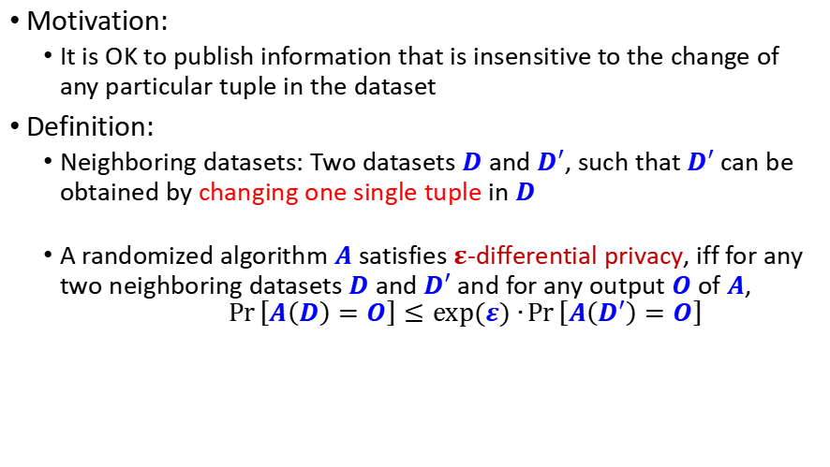
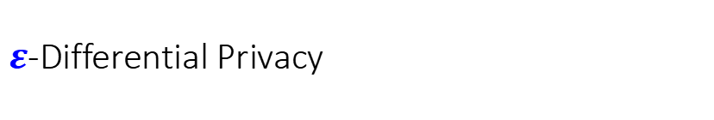
$ε$-Differential Privacy
Motivation:
It is OK to publish information that is insensitive to the change of any particular tuple in the dataset
Definition:
Neighboring datasets: Two datasets $D$ and $D′$, such that $D′$can be obtained by changing one single tuple in $D$
A randomized algorithm $A$ satisfies $ε$-differential privacy, iff for any two neighboring datasets $D$ and $D′$ and for any output $O$of $A$, $$\operatorname{Pr}\left[A\left(D\right)=O\right]≤exp⁡(ε)∙\operatorname{Pr}\left[A\left(D′\right)=O\right]$$

Slide 53
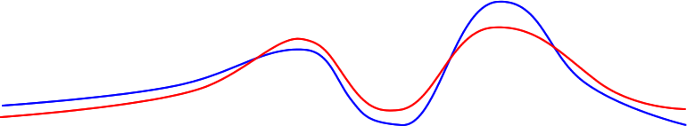





$ε$-Differential Privacy
ratio
$$≤exp⁡(ε)$$
$$\operatorname{Pr}\left[A\left(D\right)=O\right]$$
$$\operatorname{Pr}\left[A\left(D′\right)=O\right]$$
Intuition:
It is OK to publish information that is insensitive to changes of any particular tuple
Definition:
Neighboring datasets: Two datasets $D$ and $D′$, such that $D′$can be obtained by changing one single tuple in $D$
A randomized algorithm $A$ satisfies $ε$-differential privacy, iff for any two neighboring datasets $D$ and $D′$ and for any output $O$of $A$, $$\operatorname{Pr}\left[A\left(D\right)=O\right]≤exp⁡(ε)∙\operatorname{Pr}\left[A\left(D′\right)=O\right]$$
The value of $ε$ decides the degree of privacy protection
$$O$$

Slide 54




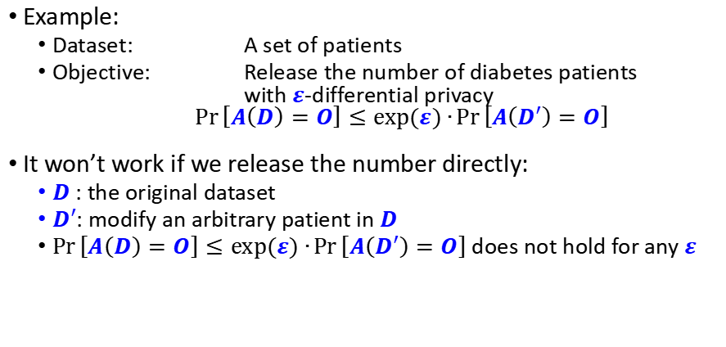

Achieving $ε$-Differential Privacy
Example:
Dataset: A set of patients
Objective: Release the number of diabetes patients with $ε$-differential privacy
$$\operatorname{Pr}\left[A\left(D\right)=O\right]≤exp⁡(ε)∙\operatorname{Pr}\left[A\left(D′\right)=O\right]$$
It won’t work if we release the number directly:
$D$: the original dataset
$D′$: modify an arbitrary patient in $D$
$\operatorname{Pr}\left[A\left(D\right)=O\right]≤exp⁡(ε)∙\operatorname{Pr}\left[A\left(D′\right)=O\right]$ does not hold for any $ε$
$$\operatorname{Pr}\left[A\left(D\right)=h\right]$$
$$\operatorname{Pr}\left[A\left(D′\right)=h′\right]$$
100%
$$h$$
$$h′$$
# of diabetes patients

Slide 55
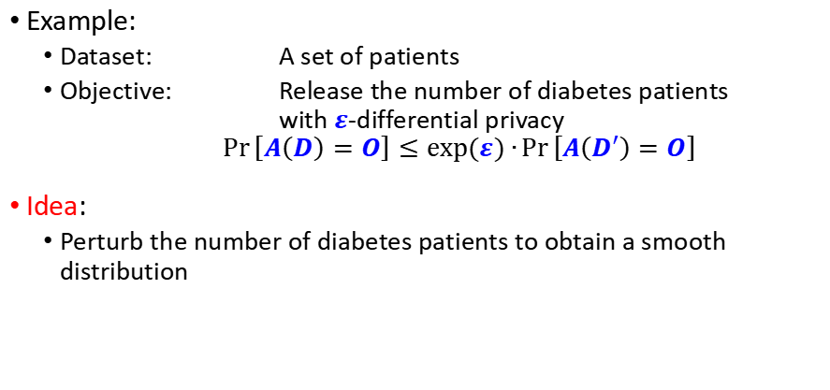
Achieving $ε$-Differential Privacy
Example:
Dataset: A set of patients
Objective: Release the number of diabetes patients with $ε$-differential privacy
$$\operatorname{Pr}\left[A\left(D\right)=O\right]≤exp⁡(ε)∙\operatorname{Pr}\left[A\left(D′\right)=O\right]$$
Idea:
Perturb the number of diabetes patients to obtain a smooth distribution
$$\operatorname{Pr}\left[A\left(D\right)=h\right]$$
$$\operatorname{Pr}\left[A\left(D′\right)=h′\right]$$
100%
$$h$$
$$h′$$
# of diabetes patients

Slide 56
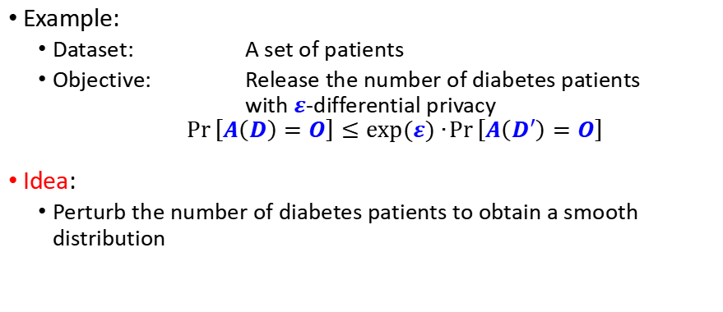
Achieving $ε$-Differential Privacy
Example:
Dataset: A set of patients
Objective: Release the number of diabetes patients with $ε$-differential privacy
$$\operatorname{Pr}\left[A\left(D\right)=O\right]≤exp⁡(ε)∙\operatorname{Pr}\left[A\left(D′\right)=O\right]$$
Idea:
Perturb the number of diabetes patients to obtain a smooth distribution
$$\operatorname{Pr}\left[A\left(D\right)=h\right]$$
$$\operatorname{Pr}\left[A\left(D′\right)=h′\right]$$
100%
$$h$$
$$h′$$
# of diabetes patients

Slide 57
Achieving $ε$-Differential Privacy
Example:
Dataset: A set of patients
Objective: Release the number of diabetes patients with $ε$-differential privacy
$$\operatorname{Pr}\left[A\left(D\right)=O\right]≤exp⁡(ε)∙\operatorname{Pr}\left[A\left(D′\right)=O\right]$$
Idea:
Perturb the number of diabetes patients to obtain a smooth distribution
ratio bounded
$$\operatorname{Pr}\left[A\left(D\right)=h\right]$$
$$\operatorname{Pr}\left[A\left(D′\right)=h′\right]$$
$$h$$
$$h′$$
# of diabetes patients

Slide 58



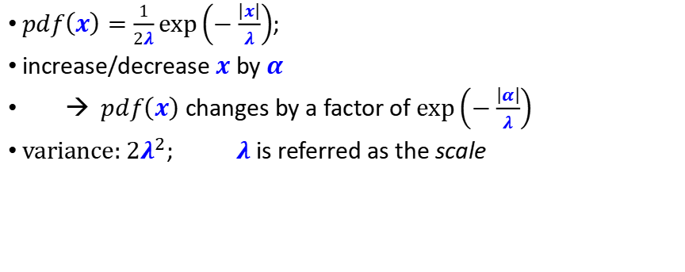
Laplace Distribution
$pdf\left(x\right)=\frac{1}{2λ}exp\left(−\frac{\left|x\right|}{λ}\right)$;
increase/decrease $x$ by $α$
→ $pdf\left(x\right)$ changes by a factor of $exp\left(−\frac{\left|α\right|}{λ}\right)$
$\text{variance}\text{: }2λ^{2}$; $λ$ is referred as the scale
$$λ=1$$
$$λ=2$$
$$λ=4$$

Slide 59





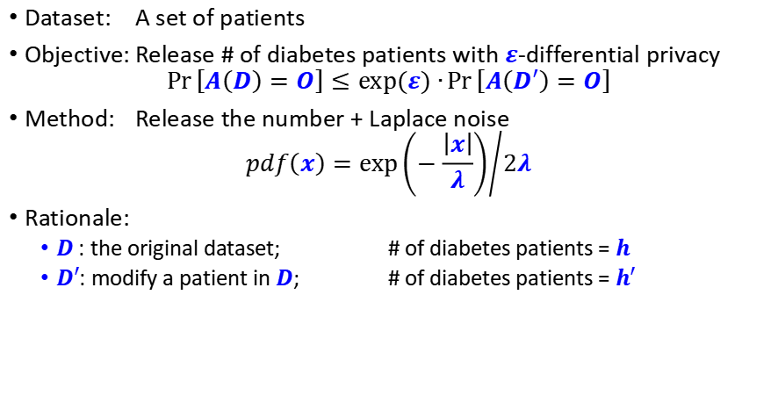
Differential Privacy via Laplace Noise
Dataset: A set of patients
Objective: Release # of diabetes patients with $ε$-differential privacy
$$\operatorname{Pr}\left[A\left(D\right)=O\right]≤exp⁡(ε)∙\operatorname{Pr}\left[A\left(D′\right)=O\right]$$
Method: Release the number + Laplace noise
$$pdf\left(x\right)={exp\left(−\frac{\left|x\right|}{λ}\right)}/{2λ}$$
Rationale:
$D$: the original dataset; # of diabetes patients = $h$
$D′$: modify a patient in $D$; # of diabetes patients = $h′$
ratio bounded
$$\operatorname{Pr}\left[A\left(D\right)=O\right]$$
$$\operatorname{Pr}\left[A\left(D′\right)=O\right]$$
$$h$$
$$y$$
$$h′$$
# of diabetes patients

Slide 60



Differential Privacy via Laplace Noise
Dataset: A set of patients
Objective: Release # of diabetes patients with $ε$-differential privacy
$$\operatorname{Pr}\left[A\left(D\right)=O\right]≤exp⁡(ε)∙\operatorname{Pr}\left[A\left(D′\right)=O\right]$$
Method: Release the number + Laplace noise
$$pdf\left(x\right)={exp\left(−\frac{\left|x\right|}{λ}\right)}/{2λ}$$
Rationale:
$D$: the original dataset; # of diabetes patients = $h$
$D′$: modify a patient in $D$; # of diabetes patients = $h′$
$$\operatorname{Pr}\left[A\left(D\right)=y\right]$$
$$=pdf(y−h)$$
$$=exp(−|y−h|/λ)/2λ$$
$$\operatorname{Pr}\left[A\left(D\right)=O\right]$$
$$h$$
$$y$$
# of diabetes patients

Slide 61



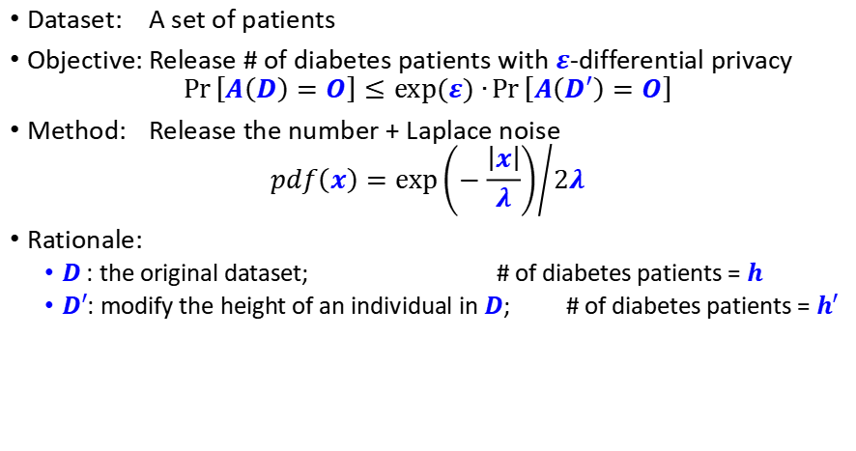
Differential Privacy via Laplace Noise
Dataset: A set of patients
Objective: Release # of diabetes patients with $ε$-differential privacy
$$\operatorname{Pr}\left[A\left(D\right)=O\right]≤exp⁡(ε)∙\operatorname{Pr}\left[A\left(D′\right)=O\right]$$
Method: Release the number + Laplace noise
$$pdf\left(x\right)={exp\left(−\frac{\left|x\right|}{λ}\right)}/{2λ}$$
Rationale:
$D$: the original dataset; # of diabetes patients = $h$
$D′$: modify the height of an individual in $D$; # of diabetes patients = $h′$
$$\operatorname{Pr}\left[A\left(D′\right)=y\right]$$
$$=pdf(y−h′)$$
$$=exp(−|y−h′|/λ)/2λ$$
$$\operatorname{Pr}\left[A\left(D′\right)=O\right]$$
$$y$$
$$h′$$
# of diabetes patients

Slide 62
Differential Privacy via Laplace Noise
Dataset: A set of patients
Objective: Release # of diabetes patients with $ε$-differential privacy
$$\operatorname{Pr}\left[A\left(D\right)=O\right]≤exp⁡(ε)∙\operatorname{Pr}\left[A\left(D′\right)=O\right]$$
Method: Release the number + Laplace noise
$$pdf\left(x\right)={exp\left(−\frac{\left|x\right|}{λ}\right)}/{2λ}$$
Rationale:
$D$: the original dataset; # of diabetes patients = $h$
$D′$: modify the height of an individual in $D$; # of diabetes patients = $h′$
$$\operatorname{Pr}\left[A\left(D′\right)=y\right]$$
$$=pdf(y−h′)$$
$$=exp(−|y−h′|/λ)/2λ$$
$$\operatorname{Pr}\left[A\left(D\right)=y\right]$$
$$=pdf(y−h)$$
$$=exp(−|y−h|/λ)/2λ$$
$$\operatorname{Pr}\left[A\left(D\right)=O\right]$$
$$\operatorname{Pr}\left[A\left(D′\right)=O\right]$$
$$h$$
$$y$$
$$h′$$
# of diabetes patients

Slide 63

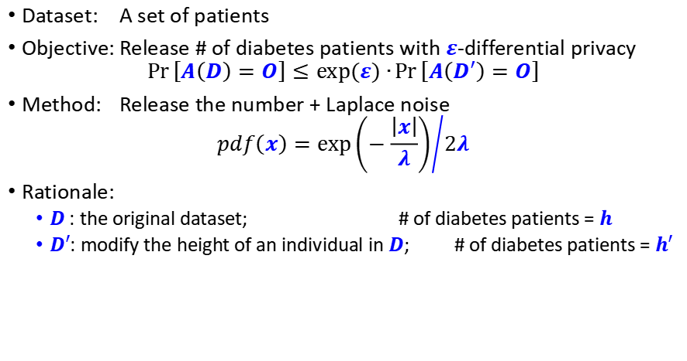
Differential Privacy via Laplace Noise
Dataset: A set of patients
Objective: Release # of diabetes patients with $ε$-differential privacy
$$\operatorname{Pr}\left[A\left(D\right)=O\right]≤exp⁡(ε)∙\operatorname{Pr}\left[A\left(D′\right)=O\right]$$
Method: Release the number + Laplace noise
$$pdf\left(x\right)={exp\left(−\frac{\left|x\right|}{λ}\right)}/{2λ}$$
Rationale:
$D$: the original dataset; # of diabetes patients = $h$
$D′$: modify the height of an individual in $D$; # of diabetes patients = $h′$
$$\frac{\operatorname{Pr}\left[A\left(D′\right)=y\right]}{\operatorname{Pr}\left[A\left(D\right)=y\right]}$$
$$=pdf(y−h′)$$
$$=exp(−|y−h′|/λ)/2λ$$
$$=pdf(y−h)$$
$$=exp(−|y−h|/λ)/2λ$$
$$\operatorname{Pr}\left[A\left(D\right)=O\right]$$
$$\operatorname{Pr}\left[A\left(D′\right)=O\right]$$
$$h$$
$$y$$
$$h′$$
# of diabetes patients

Slide 64

Differential Privacy via Laplace Noise
Dataset: A set of patients
Objective: Release # of diabetes patients with $ε$-differential privacy
$$\operatorname{Pr}\left[A\left(D\right)=O\right]≤exp⁡(ε)∙\operatorname{Pr}\left[A\left(D′\right)=O\right]$$
Method: Release the number + Laplace noise
$$pdf\left(x\right)={exp\left(−\frac{\left|x\right|}{λ}\right)}/{2λ}$$
Rationale:
$D$: the original dataset; # of diabetes patients = $h$
$D′$: modify the height of an individual in $D$; # of diabetes patients = $h′$
$$\frac{\operatorname{Pr}\left[A\left(D′\right)=y\right]}{\operatorname{Pr}\left[A\left(D\right)=y\right]}$$
$$=\frac{pdf(y−h^{′})}{pdf(y−h)}$$
$$=exp(−|y−h′|/λ)/2λ$$
$$=exp(−|y−h|/λ)/2λ$$
$$\operatorname{Pr}\left[A\left(D\right)=O\right]$$
$$\operatorname{Pr}\left[A\left(D′\right)=O\right]$$
$$h$$
$$y$$
$$h′$$
# of diabetes patients

Slide 65

Differential Privacy via Laplace Noise
Dataset: A set of patients
Objective: Release # of diabetes patients with $ε$-differential privacy
$$\operatorname{Pr}\left[A\left(D\right)=O\right]≤exp⁡(ε)∙\operatorname{Pr}\left[A\left(D′\right)=O\right]$$
Method: Release the number + Laplace noise
$$pdf\left(x\right)={exp\left(−\frac{\left|x\right|}{λ}\right)}/{2λ}$$
Rationale:
$D$: the original dataset; # of diabetes patients = $h$
$D′$: modify the height of an individual in $D$; # of diabetes patients = $h′$
$$\frac{\operatorname{Pr}\left[A\left(D′\right)=y\right]}{\operatorname{Pr}\left[A\left(D\right)=y\right]}$$
$$=\frac{pdf(y−h^{′})}{pdf(y−h)}$$
$$=\frac{exp(−|y−h′|/λ)/2λ }{exp(−|y−h|/λ)/2λ}$$
$$\operatorname{Pr}\left[A\left(D\right)=O\right]$$
$$\operatorname{Pr}\left[A\left(D′\right)=O\right]$$
$$h$$
$$y$$
$$h′$$
# of diabetes patients

Slide 66


Differential Privacy via Laplace Noise
Dataset: A set of patients
Objective: Release # of diabetes patients with $ε$-differential privacy
$$\operatorname{Pr}\left[A\left(D\right)=O\right]≤exp⁡(ε)∙\operatorname{Pr}\left[A\left(D′\right)=O\right]$$
Method: Release the number + Laplace noise
$$pdf\left(x\right)={exp\left(−\frac{\left|x\right|}{λ}\right)}/{2λ}$$
Rationale:
$D$: the original dataset; # of diabetes patients = $h$
$D′$: modify the height of an individual in $D$; # of diabetes patients = $h′$
$$\frac{\operatorname{Pr}\left[A\left(D′\right)=y\right]}{\operatorname{Pr}\left[A\left(D\right)=y\right]}$$
$$=\frac{pdf(y−h^{′})}{pdf(y−h)}$$
$$=\frac{exp(−|y−h′|/λ) }{exp(−|y−h|/λ)}$$
$$≤\exp\left(\frac{\left|h−h^{′}\right|}{λ}\right)$$
$$\operatorname{Pr}\left[A\left(D\right)=O\right]$$
$$\operatorname{Pr}\left[A\left(D′\right)=O\right]$$
$$h$$
$$y$$
$$h′$$
# of diabetes patients

Slide 67
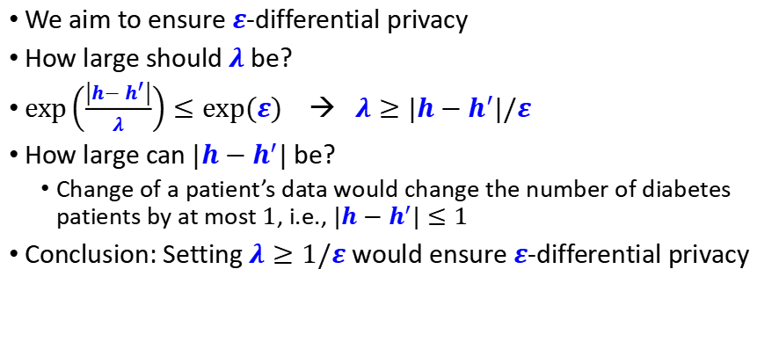
Differential Privacy via Laplace Noise
We aim to ensure $ε$-differential privacy
How large should $λ$ be?
$\exp\left(\frac{\left|h−h^{′}\right|}{λ}\right)≤exp⁡(ε)$ → $λ≥|h−h^{′}|/ε$
How large can $|h−h^{′}|$ be?
Change of a patient’s data would change the number of diabetes patients by at most $1$, i.e., $|h−h^{′}|≤1$
Conclusion: Setting $λ≥1/ε$ would ensure $ε$-differential privacy
$$\frac{\operatorname{Pr}\left[A\left(D′\right)=y\right]}{\operatorname{Pr}\left[A\left(D\right)=y\right]}$$
$$=\frac{pdf(y−h^{′})}{pdf(y−h)}$$
$$=\frac{exp(−|y−h′|/λ) }{exp(−|y−h|/λ)}$$
$$≤\exp\left(\frac{\left|h−h^{′}\right|}{λ}\right)$$
$$\operatorname{Pr}\left[A\left(D\right)=O\right]$$
$$\operatorname{Pr}\left[A\left(D′\right)=O\right]$$
$$h$$
$$y$$
$$h′$$
# of diabetes patients

Slide 68

Differential Privacy via Laplace Noise
In general, if we want to release a value $v$
Add Laplace noise into $v$
To decide the scale $λ$of Laplace noise
Look at the maixmum change that can occur in $v$ (when we change one tuple in the dataset)
Set $λ$ to be proportional to the maximum change

Slide 69
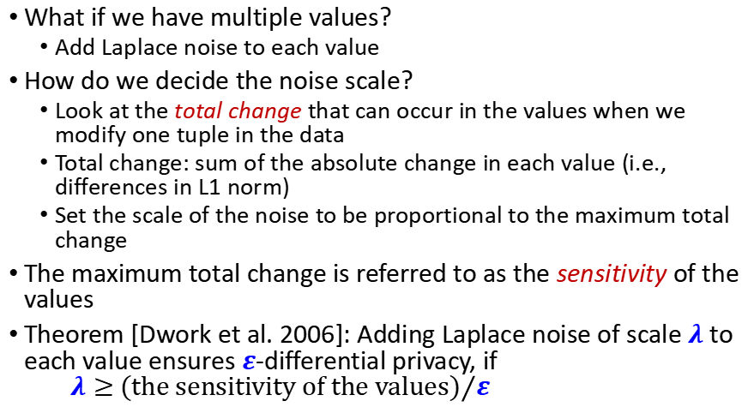
Differential Privacy via Laplace Noise
What if we have multiple values?
Add Laplace noise to each value
How do we decide the noise scale?
Look at the total change that can occur in the values when we modify one tuple in the data
Total change: sum of the absolute change in each value (i.e., differences in L1 norm)
Set the scale of the noise to be proportional to the maximum total change
The maximum total change is referred to as the sensitivity of the values
Theorem [Dwork et al. 2006]: Adding Laplace noise of scale $λ$ to each value ensures $ε$-differential privacy, if $λ≥$ ${\text{(}\text{the} \text{sensitivity} \text{of} \text{the} \text{values}\text{)}}/ε$

Slide 70
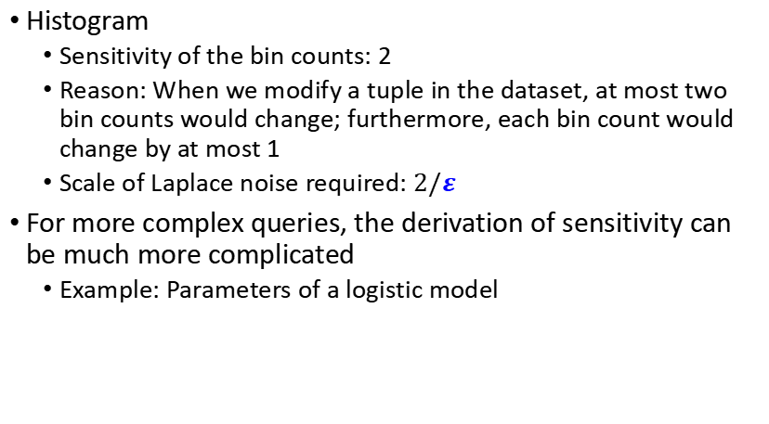
Sensitivity of Queries
Histogram
Sensitivity of the bin counts: 2
Reason: When we modify a tuple in the dataset, at most two bin counts would change; furthermore, each bin count would change by at most 1
Scale of Laplace noise required: $2/ε$
For more complex queries, the derivation of sensitivity can be much more complicated
Example: Parameters of a logistic model

Slide 71
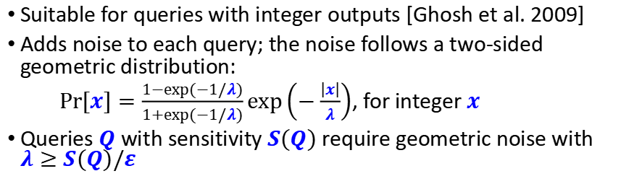
Geometric Mechanism
Suitable for queries with integer outputs [Ghosh et al. 2009]
Adds noise to each query; the noise follows a two-sided geometric distribution:
$Pr⁡[x]=\frac{1−exp⁡(−1/λ)}{1+exp⁡(−1/λ)}exp\left(−\frac{\left|x\right|}{λ}\right)$, for integer $x$
Queries $Q$with sensitivity $S(Q)$ require geometric noise with $λ≥S(Q)/ε$
Laplace
Geometric

Slide 72
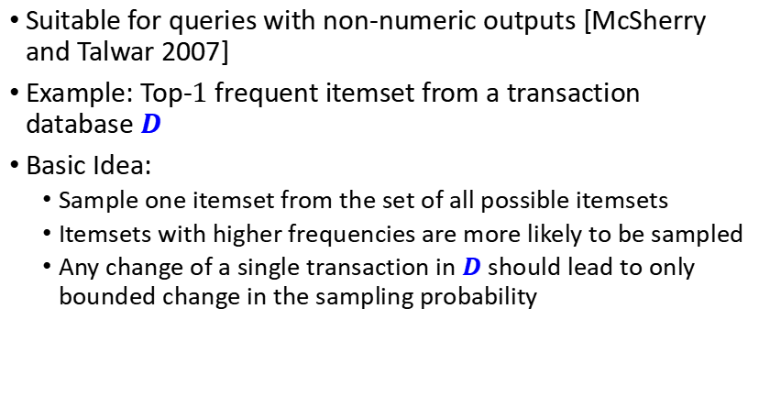
Exponential Mechanism
Suitable for queries with non-numeric outputs [McSherry and Talwar 2007]
Example: Top-$1$ frequent itemset from a transaction database $D$
Basic Idea:
Sample one itemset from the set of all possible itemsets
Itemsets with higher frequencies are more likely to be sampled
Any change of a single transaction in $D$ should lead to only bounded change in the sampling probability

Slide 73
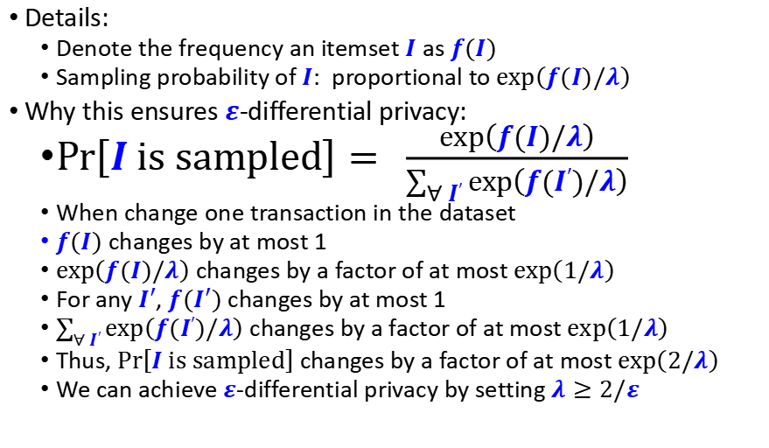
Exponential Mechanism (cont.)
Details:
Denote the frequency an itemset $I$ as $f(I)$
Sampling probability of $I$: proportional to $exp\left(f(I)/λ\right)$
Why this ensures $ε$-differential privacy:
$Pr\left[I is sampled\right]= \frac{exp\left(f(I)/λ\right)}{\sum_{∀ I′}{exp\left(f(I′)/λ\right)}}$
When change one transaction in the dataset
$f(I)$ changes by at most 1
$exp\left(f(I)/λ\right)$ changes by a factor of at most $exp\left(1/λ\right)$
For any $I′$, $f(I′)$ changes by at most 1
$\sum_{∀ I′}{exp\left(f(I′)/λ\right)}$ changes by a factor of at most $exp\left(1/λ\right)$
Thus, $Pr\left[I is sampled\right]$ changes by a factor of at most $exp\left(2/λ\right)$
We can achieve $ε$-differential privacy by setting $λ≥2/ε$

Slide 74
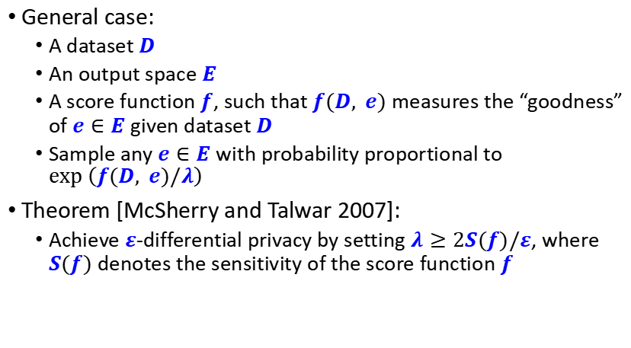
Exponential Mechanism (cont.)
General case:
A dataset $D$
An output space $E$
A score function $f$, such that $f(D, e)$ measures the “goodness” of $e∈E$ given dataset $D$
Sample any $e∈E$ with probability proportional to $exp⁡\left(f(D, e)/λ\right)$
Theorem [McSherry and Talwar 2007]:
Achieve $ε$-differential privacy by setting $λ≥2S(f)/ε$, where $S(f)$ denotes the sensitivity of the score function $f$

Slide 75
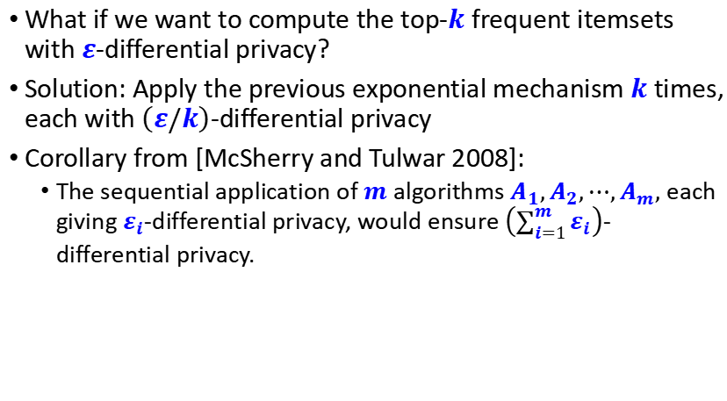
Composition of Differential Privacy
What if we want to compute the top-$k$ frequent itemsets with $ε$-differential privacy?
Solution: Apply the previous exponential mechanism $k$times, each with $\left(ε/k\right)$-differential privacy
Corollary from [McSherry and Tulwar 2008]:
The sequential application of $m$ algorithms $A_{1},A_{2},⋯,A_{m},$ each giving $ε_{i}$-differential privacy, would ensure $\left(\sum_{i=1}^{m}{ε_{i}}\right)$-differential privacy.

Slide 76
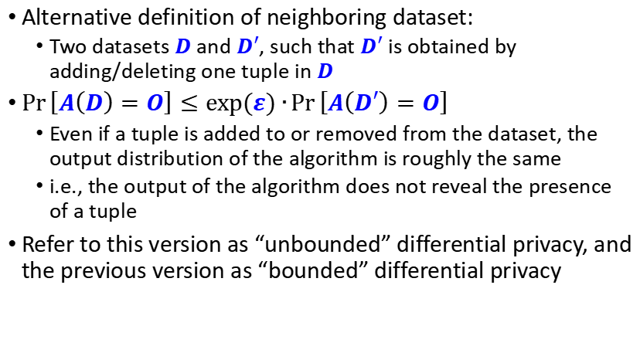
Variants of Differential Privacy
Alternative definition of neighboring dataset:
Two datasets $D$ and $D′$, such that $D′$ is obtained by adding/deleting one tuple in $D$
$\operatorname{Pr}\left[A\left(D\right)=O\right]≤exp⁡(ε)∙\operatorname{Pr}\left[A\left(D′\right)=O\right]$
Even if a tuple is added to or removed from the dataset, the output distribution of the algorithm is roughly the same
i.e., the output of the algorithm does not reveal the presence of a tuple
Refer to this version as “unbounded” differential privacy, and the previous version as “bounded” differential privacy

Slide 77
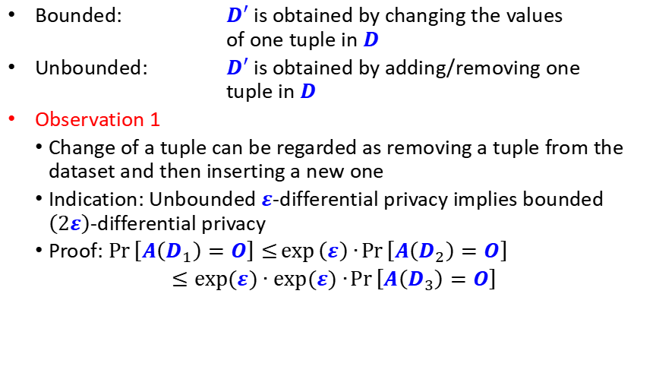
Variants of Differential Privacy
Bounded: $D′$ is obtained by changing the values of one tuple in $D$
Unbounded: $D′$ is obtained by adding/removing one tuple in $D$
Observation 1
Change of a tuple can be regarded as removing a tuple from the dataset and then inserting a new one
Indication: Unbounded $ε$-differential privacy implies bounded $\left(2ε\right)$-differential privacy
Proof: $\operatorname{Pr}\left[A\left(D_{1}\right)=O\right]≤\exp\left(ε\right)∙\operatorname{Pr}\left[A\left(D_{2}\right)=O\right]$
$≤exp⁡(ε)∙exp⁡(ε)∙\operatorname{Pr}\left[A\left(D_{3}\right)=O\right]$

Slide 78
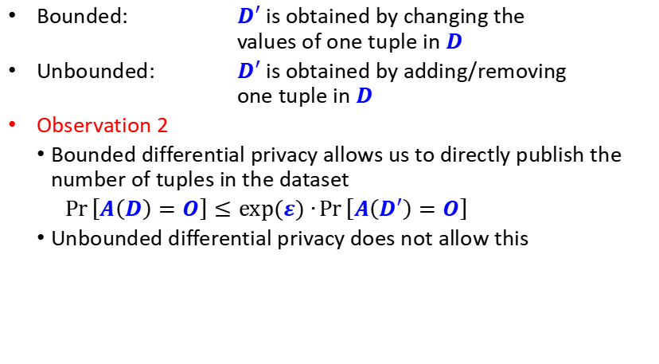
Variants of Differential Privacy
Bounded: $D′$ is obtained by changing the values of one tuple in $D$
Unbounded: $D′$ is obtained by adding/removing one tuple in $D$
Observation 2
Bounded differential privacy allows us to directly publish the number of tuples in the dataset
$\operatorname{Pr}\left[A\left(D\right)=O\right]≤exp⁡(ε)∙\operatorname{Pr}\left[A\left(D′\right)=O\right]$
Unbounded differential privacy does not allow this

Slide 79
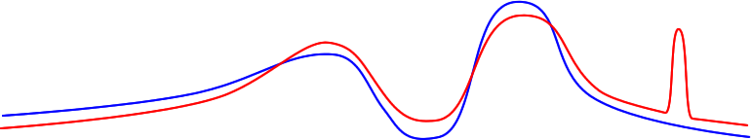
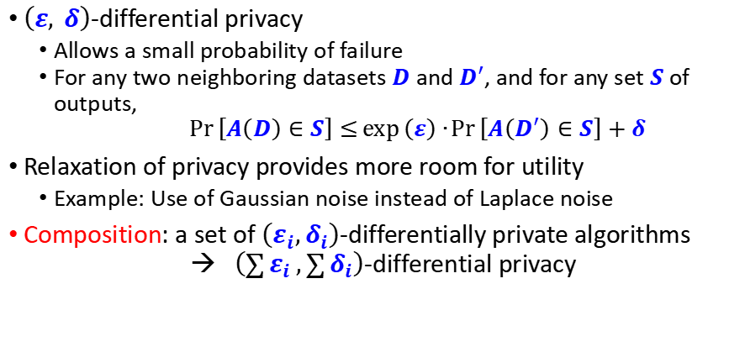
Variants of Differential Privacy
$\left(ε, δ\right)$-differential privacy
Allows a small probability of failure
For any two neighboring datasets $D$ and $D′$, and for any set $S$ of outputs, $$\operatorname{Pr}\left[A\left(D\right)∈S\right]≤\exp\left(ε\right)∙\operatorname{Pr}\left[A\left(D^{′}\right)∈S\right]+δ$$
Relaxation of privacy provides more room for utility
Example: Use of Gaussian noise instead of Laplace noise
Composition: a set of $\left(ε_{i},δ_{i}\right)$-differentially private algorithms → $\left(\sum{ε_{i}},\sum{δ_{i}}\right)$-differential privacy
Region where $ε$-differential privacy is not satisfied
$$\operatorname{Pr}\left[A\left(D\right)=O\right]$$
$$\operatorname{Pr}\left[A\left(D′\right)=O\right]$$
$$O$$

Slide 80
Limitations of Differential Privacy
Differential privacy tends to be less effective when there exist correlations among the tuples
Amount of noise needed depends on the correlations among the tuples, which is not captured by differential privacy
Example (from [Kifer and Machanavajjhala 2011]):
Bob’s family includes 10 people, and all of them are in a database
There is a highly contagious disease, such that if one family member contracts the disease, then the whole family will be infected
Differential privacy would underestimate the risk of disclosure
Differential privacy needs a trusted centralized server who publishes the anonymized data

Slide 81
Outline
Part 1
Introduction to Anonymization and Uncertainty
Tabular Data Anonymization
Part 2
Differential Privacy
Local Differential Privacy

Slide 82
Differential Privacy: A Brief Recap
A randomized algorithm K satisfies ε-differential privacy if:
Given two data sets that differ by one individual, D and D’, any property S, and ε > 0:
Pr[ K(D) ∈ S] ≤ e^{ε} Pr[ K(D’) ∈ S]
Can achieve ε-DP for counts by adding a random noise value
Uncertainty due to noise → plausible deniability
Hides whether someone is present in the data
Notes:
5 min q&a at the end of each module

Slide 83
Achieving ε-DP in the Centralized Model
(Global) Sensitivity of publishing: s = max_{D,D’} |F(D) – F(D’)|, D, D’ differ by 1 individual
E.g., count individuals satisfying property P: s = 1
For every value that is output:
Add Laplacian noise Lap(ε/s):
Or Geometric noise for discrete case:
Simple rules for composition of differentially private outputs:
Given output O₁ that is ε₁-DP and O₂ that is ε₂-DP
(Sequential composition) If inputs overlap, result is (ε₁ + ε₂)-DP
(Parallel composition) If inputs disjoint, result is max(ε₁, ε₂)-DP
Notes:
5 min q&a at the end of each module

Slide 84
Trying to Reduce Trust
Most work on differential privacy assumes a trusted party
Centralized data aggregator that sees the true, raw data
Can compute exact query answers, then perturb for privacy
A reasonable question: can we reduce the amount of trust?
Can we remove the trusted party from the equation?
Users produce locally private output, aggregate to answer queries
One approach is to use SMC or homomorphic encryption
Merge encrypted data, and add noise for privacy inside encryption
Complex to get right, and very high computational overhead

Slide 85
Local Differential Privacy
What about having each user run a DP algorithm on their data?
Then combine all the results to get a final answer
On first glance, this idea seems crazy!
Each user adds noise to mask their own input
So surely the noise will always overwhelm the signal?
But … noise can cancel out or be subtracted out
We end up with the true answer, plus noise which can be smaller
However, noise is still larger than in the centralized case

Slide 86
Local Differential Privacy: Example
Each of N users has 0/1 value, estimate total population sum
Each user adds independent Laplace noise: mean 0, variance 2/ε²
Adding user results: true answer + sum of N Laplace distributions
Error is random variable, with mean 0, variance 2N/ε²
Confidence bounds: ~95% chance of being within 2σ of the mean
So error looks like √N/ε, but true value may be proportional to N
Numeric example: suppose true answer is N/2, ε = 1, N = 1M
We see 500K ± 2800 : about 1% uncertainty
Error in centralized case would be close to 1 (0.001%)

Slide 87
Local Differential Privacy
We can achieve LDP, and obtain reasonable accuracy (for large N)
The error typically scales with √N
Generic approach: apply centralized DP algorithm to local data
But error might still be quite large
Unclear how to merge private outputs (e.g. private clustering)
So we seek to design new LDP algorithms
Maximize the accuracy of the results
Minimize the costs to the users (space, time, communication)
Ensure that there is an accurate algorithm for aggregation

Slide 88
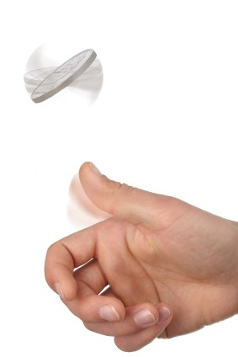
Privacy with a coin toss: Randomized Response
Each user has a single bit of private information
Encoding e.g. political/sexual/religious preference, illness, etc.
Randomize Response (RR): toss an unbiased coin [Warner 65]
If Heads (probability p = ½), report the true answer
Else, toss unbiased coin again: if Heads, report true answer, else lie
Collect responses from N users, subtract noise
Error in the estimate is proportional to 1/√N
Simple LDP algorithm with parameter ε=ln((¾)/(¼)) = ln(3)
Generalization: allow biased coins (p ≠ ½)

Slide 89



Privacy in practice
Differential privacy based on coin tossing is widely deployed!
In Google Chrome browser, to collect browsing statistics
In Apple iOS and MacOS, to collect typing statistics
In Microsoft Windows to collect telemetry data over time
From Snap to perform modeling of user preference
This yields deployments of over 100 million users each
All deployments are based on RR, but extend it substantially
To handle the large space of possible values a user might have
Local Differential Privacy is state of the art today
Randomized response invented in 1965: over five decades ago!

Slide 90

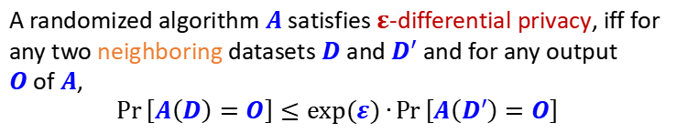
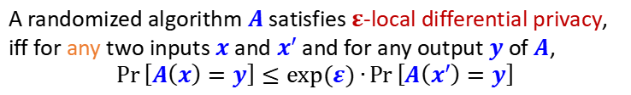
From DP to LDP: Formal Definition
Idea of DP: Any output should be about as likely regardless of whether or not I am in the dataset
A randomized algorithm $A$ satisfies $ε$-differential privacy, iff for any two neighboring datasets $D$ and $D′$ and for any output $O$of $A$, $$\operatorname{Pr}\left[A\left(D\right)=O\right]≤exp⁡(ε)∙\operatorname{Pr}\left[A\left(D′\right)=O\right]$$
A randomized algorithm $A$ satisfies $ε$-local differential privacy, iff for any two inputs $x$ and $x′$ and for any output $y$of $A$, $$\operatorname{Pr}\left[A\left(x\right)=y\right]≤exp⁡(ε)∙\operatorname{Pr}\left[A\left(x′\right)=y\right]$$
$ε$is also called privacy budget
Smaller $ε$➔ stronger privacy
Run by the server
Run by each single person
Idea of LDP: Any output should be about as likely regardless of my secret
Notes:
Feel free to interrupt

Slide 91
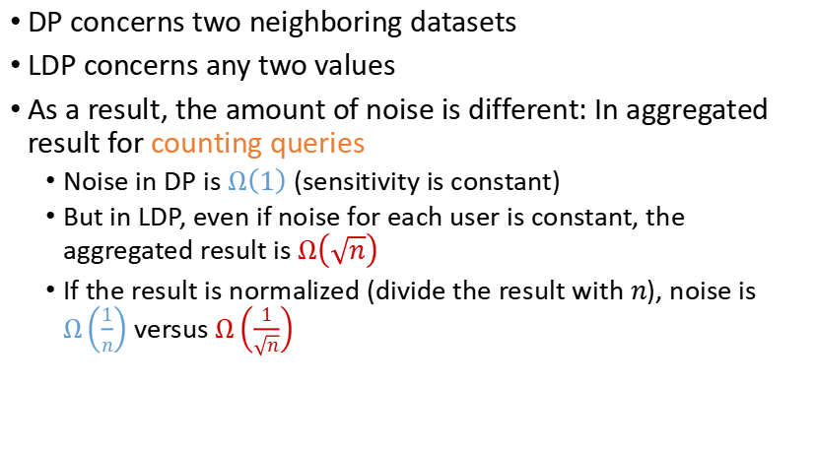
Key difference between DP and LDP
DP concerns two neighboring datasets
LDP concerns any two values
As a result, the amount of noise is different: In aggregated result for counting queries
Noise in DP is $Ω\left(1\right)$ (sensitivity is constant)
But in LDP, even if noise for each user is constant, the aggregated result is $Ω\left(\sqrt{n}\right)$
If the result is normalized (divide the result with $n$), noise is $Ω\left(\frac{1}{n}\right)$ versus $Ω\left(\frac{1}{\sqrt{n}}\right)$

